Slide 1

Iteration 2

Slide 2
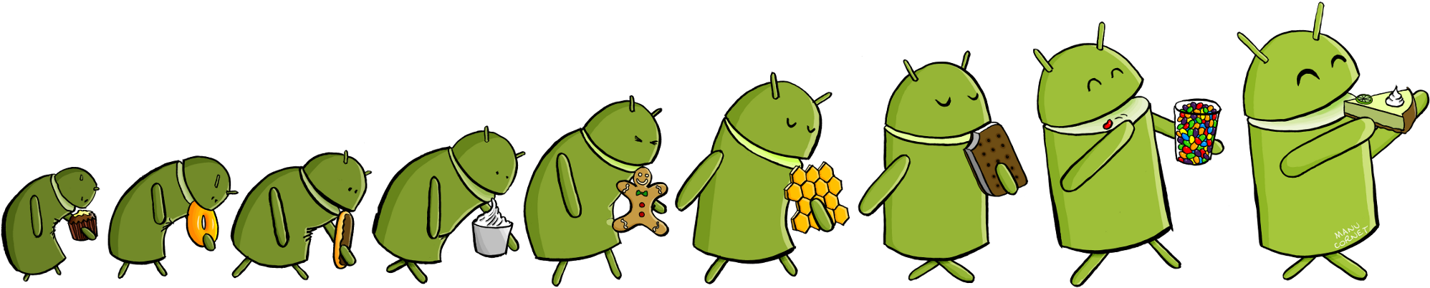
Overview
Current Software Architecture
Software Design
Testing
Requirement Analysis
Screen Shots
Project Management
Current Features
Lessons Learned
Future Work

Slide 3

Current Software Architecture
EDUkid is an Android Application to help children learn
Supports Letters, Numbers, Colors, and Shapes out of the box
Each category will allow for the parent to upload custom pictures and for letters, customer word associations
Allows for custom learning module creation

Slide 4
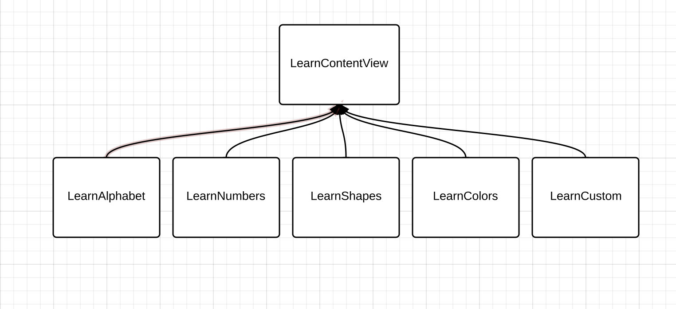
Software Design
Basic UML class diagram for learn view

Slide 5
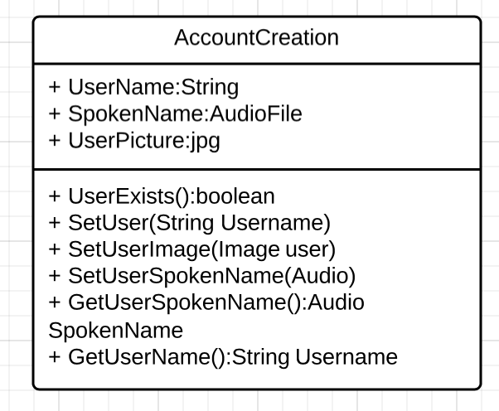
Software Design
Basic UML diagram for Account Creation

Slide 6
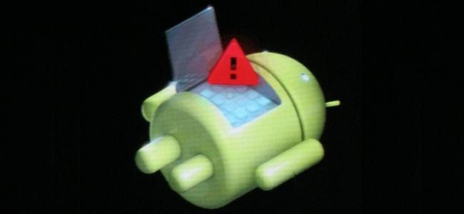
Current Testing Methodology
After each commit ensure that user data is maintained in flat file
Check User file for entry
If entry is present, display name
If entry is not present display that it is not present

Slide 7
Future Testing Methodology
Before each commit check all features on testing spreadsheet to ensure nothing is broken
Add any additional features to testing spreadsheet
Commit to current testing branch
Notify testing partner that code has been committed to testing branch
Testing partner verifies all existing functionality as well as added functionality
Notify branch maintainer that all features have been tested and double checked
Merge testing branch to main branch

Slide 8

Requirement Analysis
User stories
Account Creation Story
Setting Passcode Story
Alphabet Learn Mode Story
SQL Settings Database Story
Other tasks
Gathered images and words for Alphabet category
Refreshed app look and feel (new background images, etc.)

Slide 9
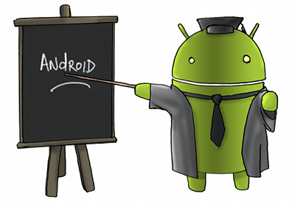
Project Management
Pivotal Tracker
8 of 10 stories completed or in progress
GitHub with 2 branches
Master branch
Development branch

Slide 10

Current Features
Alphabet Learn Mode
User Account page
Parental lock on settings page
SQL database to store settings
Images, words, etc. for each category
Audio files
User pictures

Slide 11
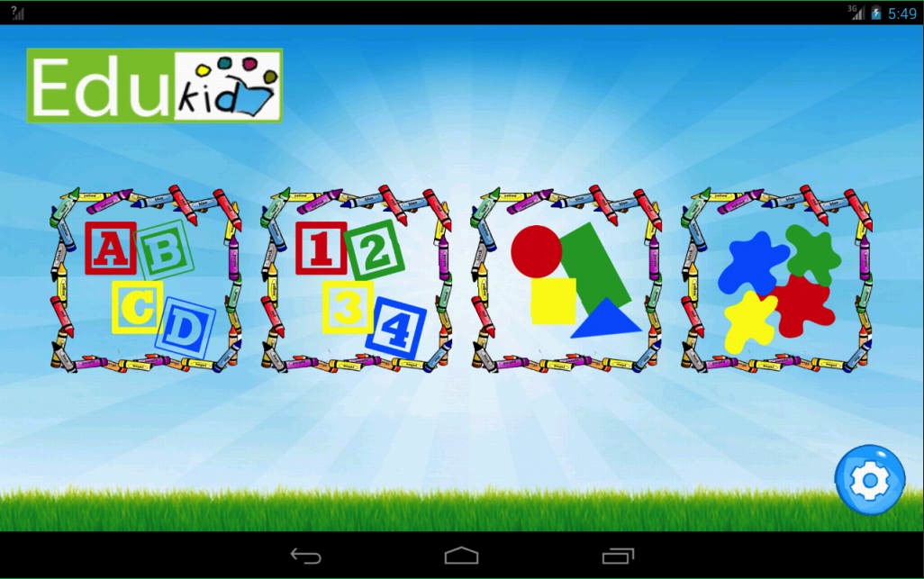
Main View

Slide 12
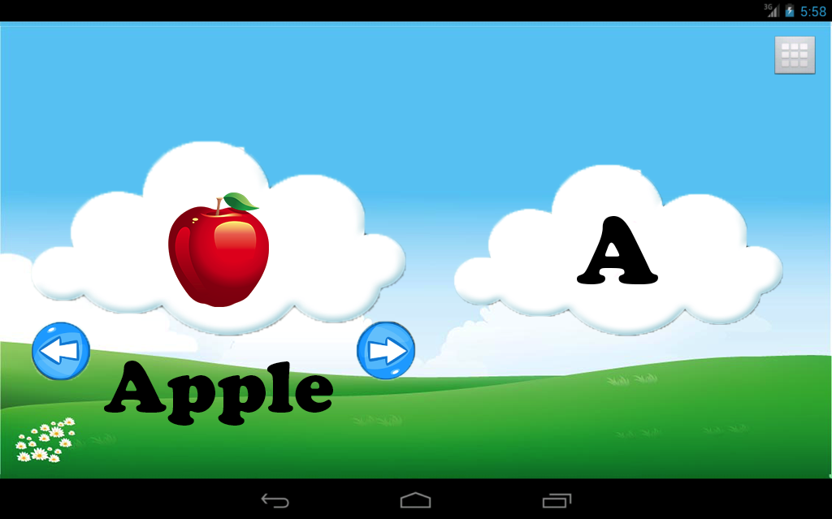
Alphabet Learn Mode View

Slide 13
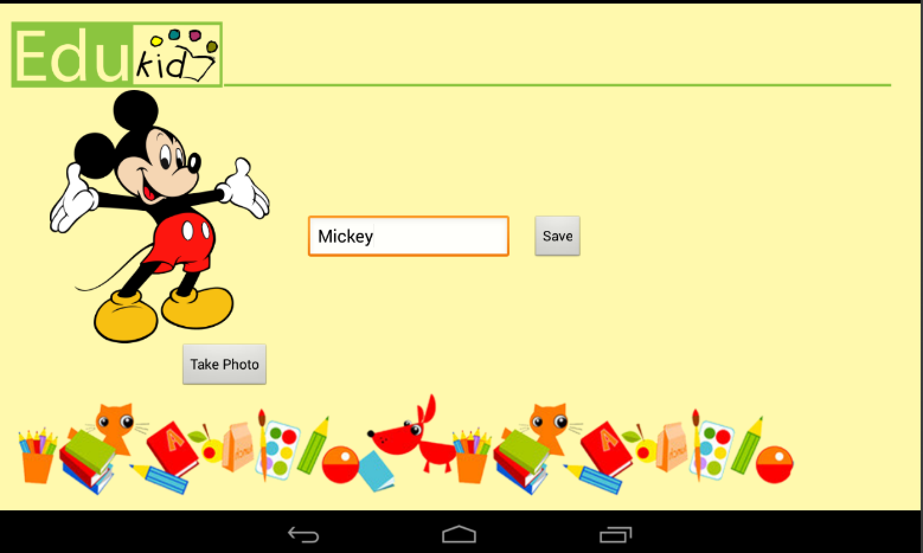
Account Creation View

Slide 14

Lessons Learned
Allocate plenty of time for coding
Communication is vital
Balancing Project work vs. documentation and class work

Slide 15
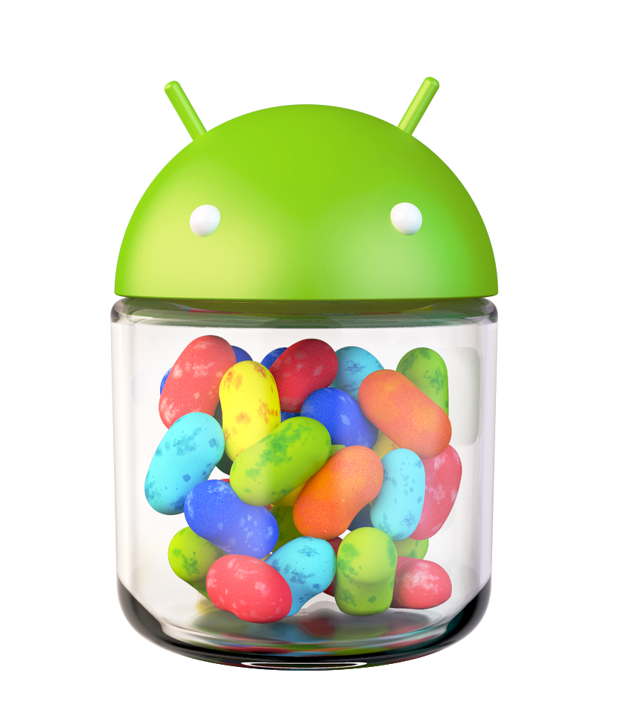
Future Work
Incorporate other categories in Learn Mode
Shapes, Colors, Numbers
Custom category
Game mode to test the child’s success
Summary page for parents to view their child’s success, and any areas that may require additional attention
Add animated GIFs to make the experience more interactive
Custom play timer to allow parents to set sensible play times
Allow for full customization with settings

